Slide 1
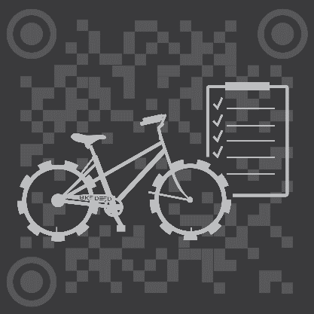
BikeDeed
Blockchain Protected.

Slide 2
BlockCHAIN Revolution?
Getting the average person to see beyond the hype of tokens, Blockchain and ICOs is a difficult task. People need to be exposed to real-world applications that are based on concepts they already understand before they will be open to the ideas that make Decentralization so exciting and revolutionary. That was the primary motivation for creating BikeDeed.
The huge market of bicycle ownership represents a unique opportunity to bring a significant portion of the world’s population into the Blockchain ecosystem, leading to further opportunities.

Slide 3
The Problem
There is currently no Universal, Trusted, Borderless, Decentralized repository for the registration, transfer and tracking of bicycles.
“So, why should I care?”

Slide 4
The Numbers
Two Billion 2,000,000,000
Number of bicycles in use around the world.
One Hundred Million 100,000,000
The number of new bicycles manufactured, shipped, sold and maintained worldwide each year.
One and a Half Million 1,500,000
Number of bicycles stolen each year in the U.S.
Five Percent 5%
Percentage of stolen bicycles returned to owners.

Slide 5
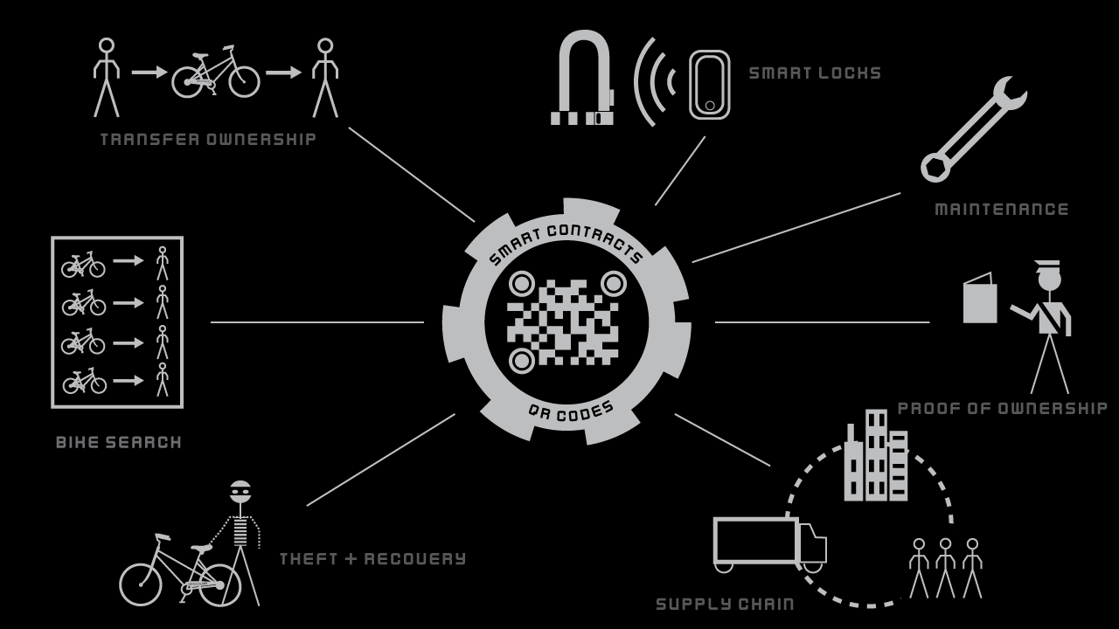
Enter BIKEDEED

Slide 6
Customer Benefits
Bike Buyers Individual Bike Buyers/Owners.
Consumer peace of mind – bike is not stolen, bike has been well maintained.
Ease of Recovery.
Proof of value.
Recommendations for Local Bike Shops for maintenance and parts.
Access to marketplaces.
Bike Sellers Individual Bike Sellers.
Proof of ownership.
Proof of value.
Access to marketplaces.
LBS Local Bike Shops.
Proof of ownership.
Access to maintenance records.
Recognition via ratings system.
OEM Original Equipment Manufacturers.
Increased sales.
Proof of value.
Easy access to marketplace.
Law Enforcement Police.
Less theft.
Ease of recovery.
Proof of value.

Slide 7
Revenue Streams
A Buck a Bike Flat fee for OE Manufacturers.
One Dollar fee for entering BikeDeed ecosystem.
Sales Channels Bike Components/Smart Locks.
Bike Product sales projected to be 62 Billion Dollar Industry by 2024.
Big Data Value Added Reseller.
Unique niche in the value chain for maximum sales opportunities.
Insurance Referral Partnerships Renter’s, Home Owner’s, (and Bicycle?) Insurance.
Up to 20 – 30% profit from premium of cross-sales.
Wallet Referral Partnerships Trust, Cipher, etc.
Up to 20 – 30% profit from premium of cross-sales.

Slide 8
Transaction Events
The following Transaction Events remain part of the public record on the Blockchain.
Bike is labeled with a QR Code/NFC and registered on the Blockchain at the factory.
When bike is shipped to the wholesaler, the BikeDeed dApp is used to transfer ownership of the the ERC 721 deed to the wholesaler’s wallet.
The transfer ownership process occurs again when the bike is shipped to the Local Bike Shop for retail sale.
When the bike is finally sold to an individual - or between individuals – ownership of the bicycle’s deed is transferred from one individual’s wallet to another.
At every stage of the bicycle’s voyage, the QR code on the bicycle is used to record the time and location of each supply-chain transaction making it a public record on the Blockchain.
Every time maintenance is performed on the bike, the QR code and BikeDeed dApp is used to record the time, location, cost and description of the work.
This rich Blockchain history deters theft and facilitates recovery – especially in the case of international trafficking. It also increases trust among buyers, sellers and retailers.

Slide 9
Competition/Partners
Bike Index.
Bike Guard
National Bike Registry
Bike Registry (Global)
Bike Index is the largest competitor with over 186,000 Registered Bikes. All of these competitors have a fairly narrow and altruistic goal - to prevent theft and facilitate recovery of stolen bikes. While BikeDeed sees itself competing with these organizations for users, we ultimately see ourselves partnering with or even joining these organizations. BikeDeed sees theft and recovery as only one piece of a much larger puzzle.

Slide 10
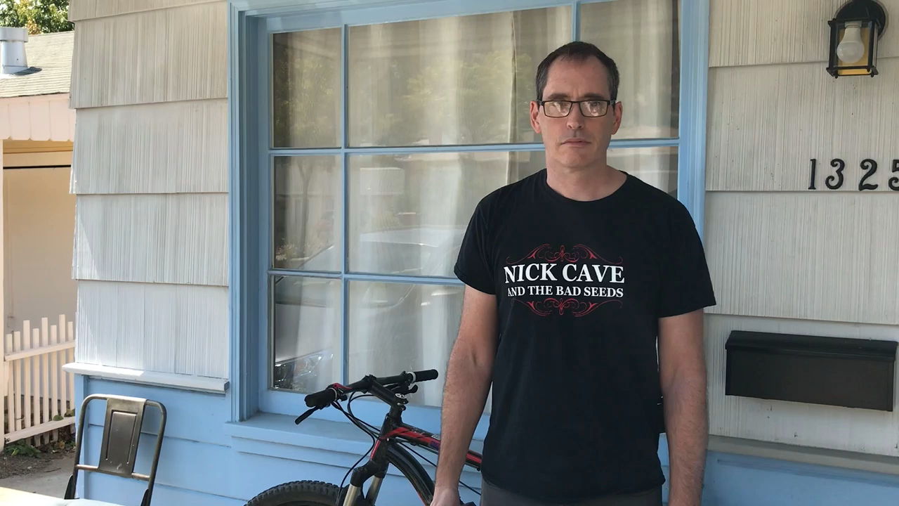
The 30 Second Demo

Slide 11
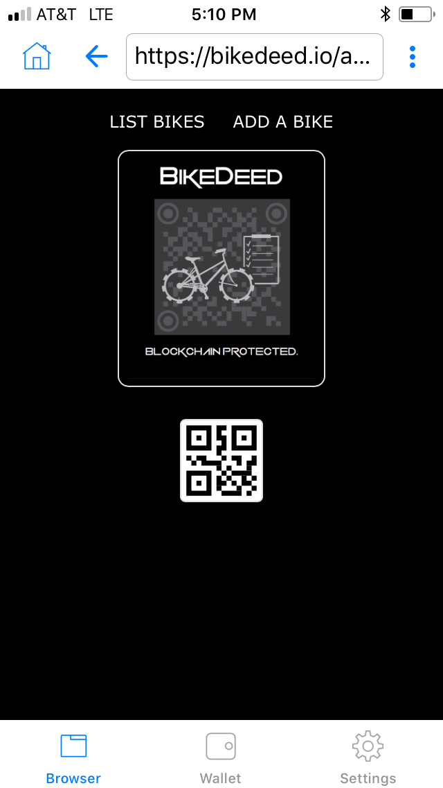
Feature RECAP
Proof of Ownership
Transfer of Ownership.
Theft and Recovery
Maintenance Tracking.
Supply Chain Tracking.
Bike Record Searching.
Smart Locks.
Rating Systems.
Bike Valuation.
Points Systems.

Slide 12
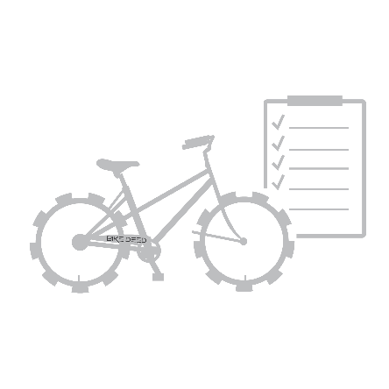
The Geek Stuff
BikeDeed is a Decentralized Registration and Tracking Application running as a Smart Contract on the Ethereum Blockchain. Technologies include:
Inter-Planetary File System
ERC721 non-fungible tokens
Web3
The Minimum Viable Product is up and running on the Ethereum Mainnet now. Go to https://bikedeed.io/app

